Slide 1
Module 6: CS 09
Patterns – Part 1
Layers
Harvinder S Jabbal
SSZG653 Software Architectures

Slide 2
Introducing Patterns

Slide 3
Patterns
An architectural pattern establishes a relationship between:
        A context.
        A problem.
        A solution.

Slide 4
Context
A context.
A recurring, common situation in the world that gives rise to a problem.

Slide 5
Problem
A problem.
The problem, appropriately generalized, that arises in the given context.

Slide 6
Solution
A solution.
A successful architectural resolution to the problem, appropriately abstracted. The solution for a pattern is determined and described by:
  A set of element types (for example, data repositories, processes, and objects)
  A set of interaction mechanisms or connectors (for example, method calls, events, or message bus)
  A topological layout of the components
  A set of semantic constraints covering topology, element behavior, and interaction mechanisms

Slide 7
Properties of Patterns
Problem…Context…Solution
Existing, well-proven design experience
Identify and Specify Abstractions
Provide Common Vocabulary
Means of documenting Software Architecture
Support construction with defined properties
Help build complex and heterogenous architectures
Help to manage software complexity

Slide 8
Problem…Context…Solution
A pattern addresses a recurring design problem that arises in specific design situations, and presents a solution to it.
If the problem is supporting variability in user interfaces. This problem may arise when developing software systems with human-computer interaction. You can solve this problem by a strict separation of responsibilities: the core functionality of the application is separated from its user interface.

Slide 9
Existing, well-proven design experience
Patterns document existing, well-proven design experience.
They are not invented or created artificially.
Rather they distill and provide a means to reuse the design knowledge gained by experienced practitioners
Those familiar with an adequate set of patterns 'can apply them immediately to design problems without having to rediscover them’
Instead of knowledge existing only in the heads of a few experts, patterns make it more generally available.
You can use such expert knowledge to design high-quality software for a specific task.
The Model-View-Controller pattern, for example, presents experience gained over many years of developing interactive systems. Many well-known applications already apply the Model- View-Controller pattern-it is the classical architecture for many Smalltalk applications, and under several application frameworks such as MacApp/Windows Apps.

Slide 10
Identify and Specify Abstractions
Patterns identify and specify abstractions that are above the level of single classes and instances, or of components.
Typically, a pattern describes several components, classes or objects, and details their responsibilities and relationships, as well as their cooperation.
All components together solve the problem that the pattern addresses, and usually more effectively than a single component.
Example, the Model-View-Controller pattern describes a triad of three cooperating components, and each MVC triad also cooperates with other MVC triads of the system.

Slide 11
Provide Common Vocabulary
Patterns provide a common vocabulary and understanding for design principles.
Pattern names, if chosen carefully, become part of a widespread design language.
They facilitate effective discussion of design problems and their solutions.
They remove the need to explain a solution to a particular problem with a lengthy and complicated description.
Instead, you can use a pattern name, and explain which parts of a solution correspond to which components of the pattern, or to which relationships between them.
Example, the name 'Model-View-Controller' and the associated pattern has been to the Smalltalk community since the early '80s and is used by many software engineers. When we say, 'the architecture of the software follows Model-View-Controller', all our colleagues who are familiar with the pattern have an idea of the basic structure and properties of the application immediately.

Slide 12
Means of documenting Software Architecture
Patterns are a means of documenting software architectures.
They can describe the vision you have in mind when designing a software system.
This helps others to avoid violating this vision when extending and modifying the original architecture, or when modifying the system's code.
Example, if you know that a system is structured according to the Model-View-Controller pattern, you also know how to extend it with a new function: keep core functionality separate from user input and information display.

Slide 13
Support construction with defined properties
Patterns support the construction of software with defined properties.
Patterns provide a skeleton of functional behaviour and therefore help to implement the functionality of your application
Example, patterns exist for maintaining consistency between cooperating components and for providing transparent peer-to-peer inter-process communication. In addition, patterns explicitly address non- functional requirements for software systems, such as changeability, reliability, testability or reusability.
The Model-View-Controller pattern, for example, supports the changeability of user interfaces and the reusability of core functionality.

Slide 14
Help build complex and heterogenous architectures
Patterns help you build complex and heterogeneous software architectures.
Every pattern provides a predefined set of components, roles and relationships between them.
It can be used to specify particular aspects of concrete software structures.
Patterns 'act as building-blocks for constructing more complex designs’.
This method of using predefined design artefacts supports the speed and the quality of your design.
Understanding and applying well-written patterns saves time when compared to searching for solutions on your own.
This is not to say that individual patterns will necessarily be better than your own solutions, but, at the very least. a pattern system can help you to evaluate and assess design alternatives.

Slide 15
….cont.
However, although a pattern determines the basic structure of the solution to a particular design problem, it does not specify a fully detailed solution.
A pattern provides a scheme for a generic solution to a family of problems, rather than a prefabricated module that can be used 'as is’.
You must implement this scheme according to the specific needs of the design problem at hand.
A pattern helps with the creation of similar units.
These units can be alike in their broad structure, but are frequently quite different in their detailed appearance.
Patterns help solve problems, but they do not provide complete solutions.

Slide 16
Help to manage software complexity
Patterns help you to manage software complexity.
Every pattern describes a proven way to handle the problem it addresses: the kinds of components needed, their roles, the details that should be hidden, the abstractions that should be visible, and how everything works.
When you encounter a concrete design situation covered by a pattern there is no need to waste time inventing a new solution to your problem.
If you implement the pattern correctly, you can rely on the solution it provides.
The Model-View-Controller pattern, for example, helps you to separate the different user interface aspects of a software system and provide appropriate abstractions for them.

Slide 17
Definition: Pattern
A pattern for software architecture describes a particular recurring design problem that arises in specific design contexts, and presents a well-proven generic scheme for its solution. The solution scheme is specified by describing its constituent components, their responsibilities and relationships, and the ways in which they collaborate.

Slide 18
Categories
From Mud to Structure.
Patterns in this category help you to avoid a 'sea' of components or objects.
In particular, they support a controlled decomposition of an overall system task into cooperating subtasks.
The category includes
  the Layers pattern
  the Pipes and Filters pattern
  the Blackboard pattern
Distributed Systems.
This category includes one pattern.
  Broker
and refers to two patterns in other categories,
  Microkernel
  Pipes and Filters
The Broker pattern provides a complete infrastructure for distributed applications.
The Microkernel and Pipes and Filters patterns only consider distribution as a secondary concern and are therefore listed under their respective primary categories.
Interactive Systems.
This category comprises two patterns,
  the Model-View-Controller pattern (well-known from Smalltalk,)
  the Presentation-Abstraction-Control pattern.
Both patterns support the structuring of software systems that feature human-computer interaction.
Adaptable Systems.
This category includes
  The Reflection pattern
  the Microkernel pattern
strongly support extension of applications and their adaptation to evolving technology and changing functional requirements.

Slide 19
From Mud to Structure: Layers

Slide 20
From Mud to Structure: Layers
Context:
All complex systems experience the need to develop and evolve portions of the system independently. For this reason, the developers of the system need a clear and well-documented separation of concerns, so that modules of the system may be independently developed and maintained.

Slide 21
From Mud to Structure: Layers
Problem:
The software needs to be segmented in such a way that the modules can be developed and evolved separately with little interaction among the parts, supporting portability, modifiability, and reuse.

Slide 22
From Mud to Structure: Layers
Solution:
To achieve this separation of concerns, the layered pattern divides the software into units called layers. Each layer is a grouping of modules that offers a cohesive set of services. The usage must be unidirectional. Layers completely partition a set of software, and each partition is exposed through a public interface.

Slide 23
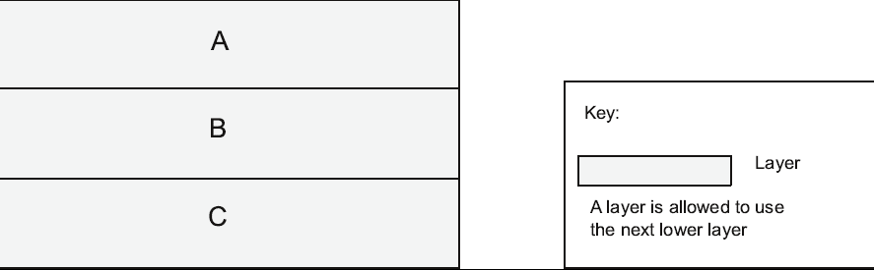
Layer: Diagramatical Representation

Slide 24
A Typical Solution
Overview:
The layered pattern defines layers (groupings of modules that offer a cohesive set of services) and a unidirectional allowed-to-use relation among the layers.
Elements:
Layer, a kind of module. The description of a layer should define what modules the layer contains.
Relations:
Allowed to use. The design should define what the layer usage rules are and any allowable exceptions.
Constraints:
  Every piece of software is allocated to exactly one layer.
  There are at least two layers (but usually there are three or more).
  The allowed-to-use relations should not be circular (i.e., a lower layer cannot use a layer above).
Weaknesses:
  The addition of layers adds up-front cost and complexity to a system.
  Layers contribute a performance penalty.

Slide 25
Thank you
End of Part 1 or 4

Slide 26
Module 6: CS 09
Patterns – Part 2 Mud to Structures: Layer/Pipes and Filters/BlackBoard
Harvinder S Jabbal
SSZG653 Software Architectures

Slide 27
Categories
From Mud to Structure.
Patterns in this category help you to avoid a 'sea' of components or objects.
In particular, they support a controlled decomposition of an overall system task into cooperating subtasks.
The category includes
  the Layers pattern
  the Pipes and Filters pattern
  the Blackboard pattern
Distributed Systems.
This category includes one pattern.
  Broker
and refers to two patterns in other categories,
  Microkernel
  Pipes and Filters
The Broker pattern provides a complete infrastructure for distributed applications.
The Microkernel and Pipes and Filters patterns only consider distribution as a secondary concern and are therefore listed under their respective primary categories.
Interactive Systems.
This category comprises two patterns,
  the Model-View-Controller pattern (well-known from Smalltalk,)
  the Presentation-Abstraction-Control pattern.
Both patterns support the structuring of software systems that feature human-computer interaction.
Adaptable Systems.
This category includes
  The Reflection pattern
  the Microkernel pattern
strongly support extension of applications and their adaptation to evolving technology and changing functional requirements.

Slide 28
From Mud to Structure
  the Layers pattern
  the Pipes and Filters pattern
  the Blackboard pattern

Slide 29
From Mud to Structure: Layers

Slide 30
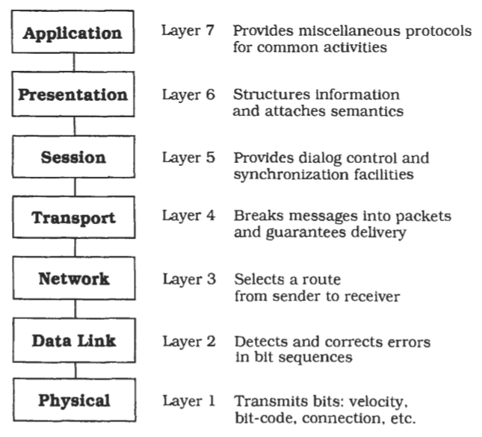
Layers- OSI 7 Layer Model

Slide 31
Implementation Steps
Define the abstraction criterion for grouping tasks into layers.
Determine the number of abstraction levels according to your abstraction criterion.
Name the layers and assign tasks to each of them.
Specify the services.
Refine the layering.
Specify an interface for each layer.
Structure individual layers.
Specify the communication between adjacent layers.
Decouple adjacent layers.
Design an error-handling strategy.

Slide 32
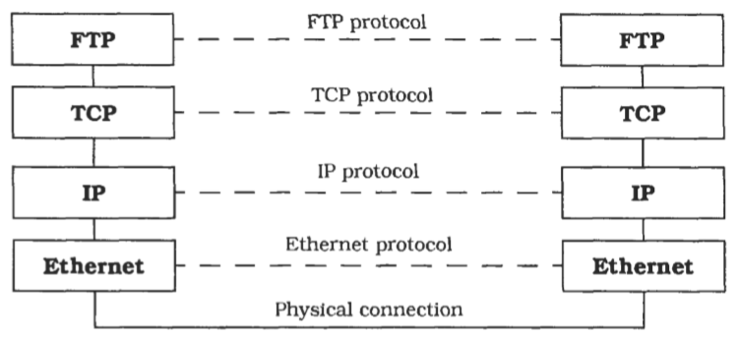
Variant of OSI: TCP/IP

Slide 33
Variant: Relaxed Layered System
This is a variant of the Layers pattern that is less restrictive about the relationship between layers.
In a Relaxed Layered System each layer may use the services of all layers below it, not only of the next lower layer.
A layer may also be partially opaque- this means that some of its services are only visible to the next higher layer, while others are visible to all higher layers.
The gain of flexibility and performance in a Relaxed Layered System is paid for by a loss of maintainability.
This is often a high price to pay, and you should con- sider carefully before giving in to the demands of developers asking for shortcuts.
We see these shortcuts more often in infrastructure systems, such as the UNIX operating system or the X Window System, than in application software.
The main reason for this is that infra-structure systems are modified less often than application systems, and their performance is usually more important than their maintainability.

Slide 34
Variant: Layering Through Inheritance.
This variant can be found in some object-oriented systems.
In this variant lower layers are implemented as base classes.
A higher layer requesting services from a lower layer inherits from the lower layer's implementation and hence can issue requests to the base class services.
An advantage of this scheme is that higher layers can modify lower-layer services according to their needs.
A drawback is that such an inheritance relationship closely ties the higher layer to the lower layer.
If for example the data layout of a C++ base class changes, all subclasses must be recompiled.
Such unintentional dependencies introduced by inheritance are also known as the fragile base class problem.

Slide 35
Known Usages:
Virtual Machines. We can speak of lower levels as a virtual machine that insulates higher levels from low-level details or varying hardware. For example, the Java Virtual Machine (JVM) defines a binary code format. Code written in the Java programming language is translated into a platform-neutral binary code, also called byte- codes, and delivered to the JVM for interpretation. The JVM itself is platform-specific-there are implementations of the JVM for different operating systems and processors. Such a two-step translation process allows platform-neutral source code and the delivery of binary code not readable to humans1, while maintaining platform- independency.

Slide 36
Known Usages:
APIs. An Application Programming Interface is a layer that encapsu- lates lower layers of frequently-used functionality. An API is usually a flat collection of function specifications, such as the UNIX system calls. 'Flat' means here that the system calls for accessing the UNIX file system. These libraries provide the benefit of portabil- ity between different operating systems, and provide additional higher-level services such as output buffering or formatted output. They often carry the liability of lower efficiency2, and perhaps more tightly-prescribed behavior, whereas conventional system calls would give more flexibility-and more opportunities for errors and concep- tual mismatches, mostly due to the wide gap between high-level application abstractions and low-level system calls.

Slide 37
Known Usages:
Information Systems (IS) from the business software domain often use a two-layer architecture. The bottom layer is a database that holds company-specific data. Many applications work concurrently on top of this database to fulfill different tasks. Mainframe interactive systems and the much-extolled Client-Server systems often employ this architecture. Because the tight coupling of user interface and data representation causes its share of problems, a third layer is introduced between them-the domain layer-which models the conceptual structure of the problem domain. As the top level still mixes user interface and application, this level is also split, resulting in a four-layer architecture. These are, from highest to lowest:
Presentation
Application logic
Domain layer
Database

Slide 38
Known Usages:
Windows NT [Cus93]. This operating system is structured according to the Microkernel pattern (171). The NT Executive component corresponds to the microkernel component of the Microkernel pattern. The NT Executive is a Relaxed Layered System, as described in the Variants section. It has the following layers:
System services: the interface layer between the subsystems and the NT Executive.
2. Input/output buffering in Mgher layers is often intended to have the inverse effect-better performance than undisciplined direct use of lower-level system calls.
@ Resource management layer: this contains the modules Object Manager, Security Reference Monitor, Process Manager, 1/0 Manager, Virtual Memory Manager and Local Procedure Calls.
@ Kernel: this takes care of basic functions such as interrupt and ex- ception handling, multiprocessor synchronization, thread schedu- ling and thread dispatching.
@ HAL (Hardware Abstraction Layer): this hides hardware differences between machines of different processor families.
@ Hardware
Windows NT relaxes the principles of the Layers pattern because the Kernel and the 1/0 manager access the underlying hardware directly for reasons of efficiency.
onsequences

Slide 39
Benefits
Benefits
Reuse of layers.
Support for standardization.
Dependencies are kept local
Liabilities
Cascades of changing behaviour.
Lower efficiency.
Unnecessary work.
Difiulty of establishing the correct granularity of layers.

Slide 40
Pipes and Filters

Slide 41
Pipes and Filters
The Pipes and Filters architectural pattern provides a structure for systems that process a stream of data. Each processing step is encapsulated in a filter component. Data is passed through pipes between adjacent filters. Recombining filters allows you to build families of related systems.

Slide 42
Pipe and Filter Pattern
Context: Many systems are required to transform streams of discrete data items, from input to output. Many types of transformations occur repeatedly in practice, and so it is desirable to create these as independent, reusable parts.
Problem: Such systems need to be divided into reusable, loosely coupled components with simple, generic interaction mechanisms. In this way they can be flexibly combined with each other. The components, being generic and loosely coupled, are easily reused. The components, being independent, can execute in parallel.
Solution: The pattern of interaction in the pipe-and-filter pattern is characterized by successive transformations of streams of data. Data arrives at a filter’s input port(s), is transformed, and then is passed via its output port(s) through a pipe to the next filter. A single filter can consume data from, or produce data to, one or more ports.

Slide 43
Problem
Imagine you are building a system that must process or transform a stream of input data. Implementing such a system as a single component may not be feasible for several reasons:
  the system has to be built by several developers,
  the global system task decomposes naturally into several processing stages, and
  the requirements are likely to change.
You therefore plan for future flexibility by exchanging or reordering the processing steps.
By incorporating such flexibility, it is possible to build a family of systems using existing processing components.

Slide 44
Problem
The design of the system-especially the interconnection of processing steps-has to consider the following forces:
Future system enhancements should be possible by exchanging processing steps or by recombination of steps, even by users.
Small processing steps are easier to reuse in different contexts than large components. Non-adjacent processing steps do not share information.
Different sources of input data exist, such as a network connection or a hardware sensor providing temperature readings, for example. It should be possible to present or store final results in various ways. Explicit storage of intermediate results for further processing in files clutters directories and is error-prone, if done by users.
You may not want to rule out multi-processing the steps, for example running them in parallel or quasi-parallel.

Slide 45
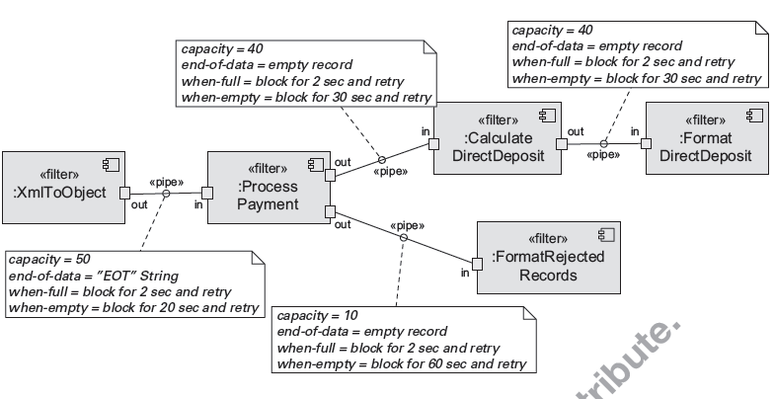
Pipe and Filter Example

Slide 46
Solution
The Pipes and Filters architectural pattern divides the task of a system into several sequential processing steps.
These steps are connected by the data flow through the system-the output data of a step is the input to the subsequent step.
Each processing step is implemented by a filter component.
A filter consumes and delivers data incrementally-in contrast to consuming all its input before producing any output-to achieve low latency and enable real parallel processing.
The input to the system is provided by a data source such as a text file.
The output flows into a data sink such as a file, terminal, animation program and so on.
The data source, the filters and the data sink are connected sequentially by pipes.
Each pipe implements the data flow between adjacent processing steps.
The sequence of filters combined by pipes is called a processing pipeline.

Slide 47
Pipe and Filter Solution
Overview: Data is transformed from a system’s external inputs to its external outputs through a series of transformations performed by its filters connected by pipes.
Elements:
  Filter, which is a component that transforms data read on its input port(s) to data written on its output port(s).
  Pipe, which is a connector that conveys data from a filter’s output port(s) to another filter’s input port(s). A pipe has a single source for its input and a single target for its output. A pipe preserves the sequence of data items, and it does not alter the data passing through.
Relations: The attachment relation associates the output of filters with the input of pipes and vice versa.
Constraints:
  Pipes connect filter output ports to filter input ports.
  Connected filters must agree on the type of data being passed along the connecting pipe.

Slide 48
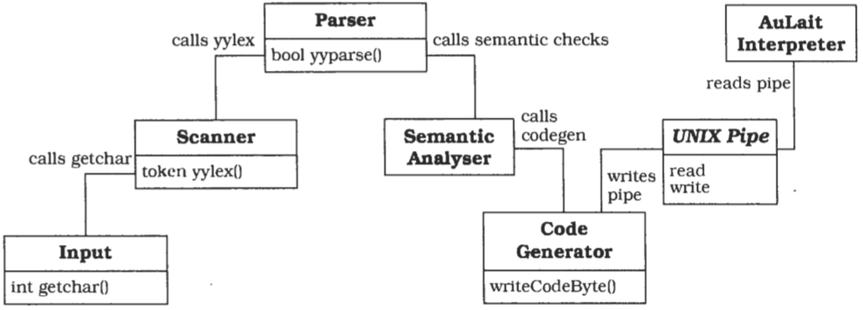
Another Example

Slide 49
Implementation Steps
Divide the system's task into a sequence of processing stages.
Define the data format to be passed along each pipe.
Decide how to implement each pipe connection.
Design and implement the fiters.
Design the error handling.
Set up the processing pipeline.
  If your system handles a single task you can use a standardized main program that sets up the pipeline and starts processing. This type of system may benefit from a direct- call pipeline, in which the main program calls the active filter to start processing.
  You can increase flexibility by providing a shell or other end-user facility to set up various pipelines from your set of filter components.
  Such a shell can support the incremental development of pipelines by allowing intermediate results to be stored in files, and supporting files as pipeline input.
  You are not restricted to a text-only shell such as those provided by UNIX, and could even develop a graphical environment for visual creation of pipelines using 'drag and drop' interaction.

Slide 50
Variant: Tee and join pipeline systems.
The single-input slngle-output filter specification of the Pipes and Filters pattern can be varied to allow filters wlth more than one input and/or more than one output.
Processing can then be set up as a directed graph that can even contain feedback loops.
The design of such a system, especially one with feedback loops, requires a solid foundation to explain and understand the complete calculation- a rigorous theoretical analysis and specification using formal methods are appropriate, to prove that the system terminates and produces the desired result.

Slide 51
Known Usage: UNIX
UNIX popularized the Pipes and Filters paradigm.
The command shells and the availability of many filter programs made this approach to system development popular.
As a system for software developers, frequent tasks such as program compilation and documentation creation are done by pipelines on a 'traditional' UNIX system.
The flexibility of UNIX pipes made the operating system a suitable platform for the binary reuse of filter programs and for application integration.

Slide 52
Known Usage: CMS Pipelines
CMS Pipelines is an extension to the operating system of IBM mainframes to support Pipes and Filters architectures.
The implementation of CMS pipelines follows the conventions of CMS, and defines a record as the basic data type that can be passed along pipes, instead of a byte or ASCII character.
CMS Pipelines provides a reuse and integration platform in the same way as UNIX.
Because the CMS operating system does not use a uniform I/O-model in the same way as UNIX, CMS Pipelines defines device drivers that act as data sources or sinks, allowing the handling of specific I/O-devices within pipelines.

Slide 53
Known Usage: LASSP Tools
LASSP Tools is a toolset to support numerical analysis and graphics.
The toolset consists mainly of filter programs that can be combined using UNIX pipes.
It contains graphical input devices for analog input of numerical data using knobs or sliders, filters for numerical analysis and data extraction, and data sinks that produce animations from numerical data streams.

Slide 54
Benefits
No intermediate files necessary, but possible.
Flexibility by filter exchange.
Flexibility by recombination.
Reuse of filter components.
Rapid prototyping of pipelines.
Egiciemy by parallel processing.

Slide 55
Liabilities
Sharing state information is expensive or inflxible.
Efficiency gain by parallel processing is often an illusion.
Data transformation overhead.
Error handling.

Slide 56
Black Board

Slide 57
Blackboard
The Blackboard architectural pattern is useful for problems for which no deterministic solution strategies are known.
In Blackboard several specialized subsystems assemble their knowledge to build a possibly partial or approximate solution.
CONTEXT
An immature domain in which no closed approach to a solution is known or feasible.

Slide 58
Problem
The Blackboard pattern tackles problems that do not have a feasible deterministic solution for the transformation of raw data into high-level data structures, such as diagrams, tables or English phrases.
Vision, image recognition, speech recognition and surveillance are examples of domains in which such problems occur.
They are characterized by a problem that, when decomposed into sub-problems, spans several fields of expertise.
The solutions to the partial problems require different representations and paradigms.
In many cases no predetermined strategy exists for how the 'partial problem solvers' should combine their knowledge.
This is in contrast to functional de-composition, in which several solution steps are arranged so that the sequence of their activation is hard-coded.

Slide 59
forces that influence solutions to these problems
A complete search of the solution space is not feasible in a reasonable time.
Since the domain is immature, you may need to experiment with different algorithms for the same subtask. Individual modules should be easily exchangeable.
There are different algorithms that solve partial problems. Unrelated logics, representations, algorithms, paradigms or domains may be involved.
An algorithm usually works on the results of other algorithms.
Uncertain data and approximate solutions are involved.
Employing disjoint algorithms induces potential parallelism. If possible you should avoid a strictly sequential solution.

Slide 60
Solution
The idea behind the Blackboard architecture is a collection of independent programs that work cooperatively on a common data structure.
Each program is specialized for solving a particular part of the overall task, and all programs work together on the solution.
These specialized programs are independent of each other.
They do not call each other, nor is there a predetermined sequence for their activation.
Instead, the direction taken by the system is mainly determined by the current state of progress.
A central control component evaluates the current state of processing and coordinates the specialized programs.
This data-directed control regime is referred to as opportunistic problem solving.
It makes experimentation with different algorithms possible, and allows experimentally-derived heuristics to control processing.
During the problem-solving process the system works with partial solutions that are combined, changed or rejected.
Each of these solutions represents a partial problem and a certain stage of its solution.
The set of all possible solutions is called the solution space, and is organized into levels of abstraction.
The lowest level of solution consists of an internal representation of the input.
Potential solutions of the overall system task are on the highest level.
The name 'blackboard was chosen because it is reminiscent of the situation in which human experts sit in front of a real blackboard and work together to solve a problem.
Each expert separately evaluates the current state of the solution, and may go up to the blackboard at any time and add, change or delete information.
Humans usually decide themselves who has the next access to the blackboard.
In the pattern we describe, a moderator component decides the order in which programs execute if more than one can make a contribution.

Slide 61
Structure
Divide your system into a component called blackboard, a collection of knowledge sources, and a control component.
The blackboard is the central data store. Elements of the solution space and control data are stored here.
We use the term vocabulary for the set of all data elements that can appear on the blackboard.
The blackboard provides an interface that enables all knowledge sources to read from and write to it.
All elements of the solution space can appear on the blackboard.
For solutions that are constructed during the problem solving process and put on the blackboard, we use the terms hypothesis or blackboard entry.
Hypotheses rejected later in the process are removed from the blackboard.

Slide 62
Components
The blackboard can be viewed as a three-dimensional problem space with the time line for speech on the X-axis, increasing levels of abstraction on the Y-axis and alternative solutions on the Z-axis
Knowledge sources are separate, independent subsystems that solve specific aspects of the overall problem. Together they model the overall problem domain. None of them can solve the task of the system alone-a solution can only be built by integrating the results of several knowledge sources.
The control component runs a loop that monitors the changes on the blackboard and decides what action to take next. It schedules knowledge source evaluations and activations according to a knowledge application strategy. The basis for this strategy is the data on the blackboard.

Slide 63
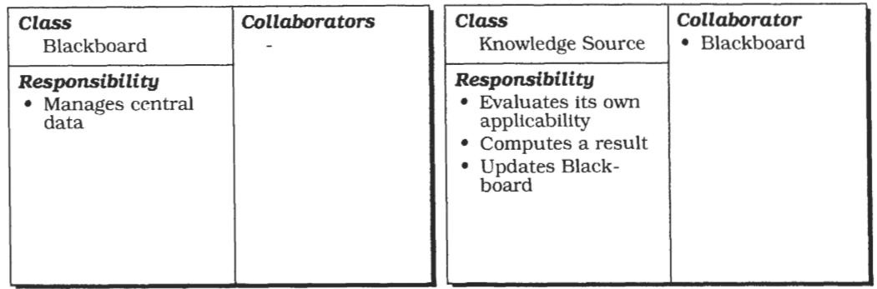
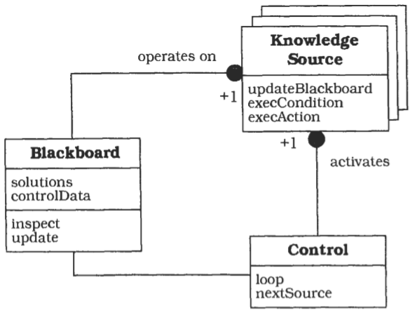
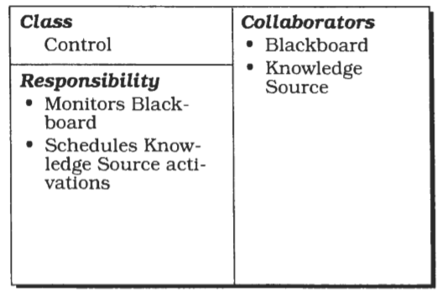
Structure

Slide 64
Steps in implementing Blackboard
Define the problem.
Define the solution spacefor the problem.
Divide the solution process into steps.
Divide the knowledge into specialized knowledge sources with certain subtasks.
Define the vocabulary of the blackboard.
Specify the control ofthe system.

Slide 65
Variant: Production System
This architecture is used in the OPS language.
In this variant subroutines are represented as condition- action rules, and data is globally available in working memory.
Condition-action rules consist of a left-hand side that specifies a condition, and a right-hand side that specifies an action.
The action is executed only if the condition is satisfied and the rule is selected.
The selection is made by a 'conflict resolution module’.
A Blackboard system can be regarded as a radical extension of the original production system formalism: arbitrary programs are allowed for both sides of the rules, and the internal complexity of the working memory is increased.
Complicated scheduling algorithms are used for conflict- resolution.

Slide 66
Variant: Repository.
This variant is a generalization of the Blackboard pattern.
The central data structure of this variant is called a repository.
In a Blackboard architecture the current state of the central data structure, in conjunction with the Control component, finally activates knowledge sources.
In contrast, the Repository pattern does not specify an internal control.
A repository architecture may be controlled by user input or by an external program.
A traditional database, for example, can be considered as a repository.
Application programs working on the database correspond to the knowledge sources in the Blackboard architecture

Slide 67
Known Usages
HEARSAY-11.
The first Blackboard system was the HEARSAY-I1 speech recognition system from the early 1970's. It was developed as a natural language interface to a literature database.
HASP/SIAP.
The HASP system was designed to detect enemy submarines. In this system, hydrophone arrays monitor a sea area by collecting sonar signals.
CRYSALIS.
This system was designed to infer the three-dimensional structure of protein molecules from X-ray diffraction data
TRICERO.
This system monitors aircraft activities
SUS: 'Software Understanding System
In a matching process the system compares patterns from a pattern base to the system under analysis.
SUS incrementally builds a 'pattern map' of the analyzed software that then can be viewed.

Slide 68
Thank you
End of Part 2 or 4

Slide 69
Module 6 CS09
Patterns – Part 3 Distributed Systems Brokers/Bridge
Harvinder S Jabbal
SSZG653 Software Architectures

Slide 70
Categories
From Mud to Structure.
Patterns in this category help you to avoid a 'sea' of components or objects.
In particular, they support a controlled decomposition of an overall system task into cooperating subtasks.
The category includes
  the Layers pattern
  the Pipes and Filters pattern
  the Blackboard pattern
Distributed Systems.
This category includes one pattern.
  Broker
and refers to two patterns in other categories,
  Microkernel
  Pipes and Filters
The Broker pattern provides a complete infrastructure for distributed applications.
The Microkernel and Pipes and Filters patterns only consider distribution as a secondary concern and are therefore listed under their respective primary categories.
Interactive Systems.
This category comprises two patterns,
  the Model-View-Controller pattern (well-known from Smalltalk,)
  the Presentation-Abstraction-Control pattern.
Both patterns support the structuring of software systems that feature human-computer interaction.
Adaptable Systems.
This category includes
  The Reflection pattern
  the Microkernel pattern
strongly support extension of applications and their adaptation to evolving technology and changing functional requirements.

Slide 71
Distributed Systems
Broker
  The Microkernel and Pipes and Filters patterns only consider distribution as a secondary concern and are therefore listed under their respective primary categories.

Slide 72
Distributed Systems: Broker

Slide 73
Broker
The Broker architectural pattern can be used to
    structure distributed software systems
    with decoupled components
    that interact by remote service invocations.
A broker component is responsible
    for coordinating communication,
    such as forwarding requests,
    as well as for transmitting results
    and exceptions.

Slide 74
Context
Your environment is a
    distributed and
    possibly heterogeneous system with
      independent
      cooperating components

Slide 75
Problem
Building a complex software system as a set of decoupled and inter-operating components, rather than as a monolithic application, results in greater flexibility, maintainability and changeability.
By partitioning functionality into independent components the system becomes potentially distributable and scalable.
However, when distributed components communicate with each other, some means of inter-process communication is required.
If components handle communication themselves, the resulting system faces several dependencies and limitations.

Slide 76
Example
The system becomes dependent on the communication mechanism used, clients need to know the location of servers, and in many cases the solution is limited to only one programming language.
Services for adding, removing, exchanging, activating and locating components are also needed.
Applications that use these services should not depend on system-specific details to guarantee portability and interoperability, even within a heterogeneous network.

Slide 77
developer's viewpoint
There should essentially be no difference between developing software for centralized systems and developing for distributed ones.
An application that uses an object should only see the interface offered by the object.
It should not need to know anything about the implementation details of an object, or about its physical location.

Slide 78
Forces balanced by Broker Architecture
Components should be able to access services provided by others through remote, location-transparent service invocations.
You need to exchange, add, or remove components at run-time.
The architecture should hide system and implementation-specific details from the users of components and services.

Slide 79
Solution
Introduce a broker component to achieve better decoupling of clients and servers.
Servers register themselves with the broker, and make their services available to clients through method interfaces.
Clients access the functionality of servers by sending requests via the broker.
A broker's tasks include locating the appropriate server, forwarding the request to the server and transmitting results and exceptions back to the client.

Slide 80
How an Application accesses distributed services
By using the Broker pattern, an application can access distributed services simply by sending message calls to the appropriate object, instead of focusing on low-level inter-process communication.
In addition, the Broker architecture is flexible, in that it allows dynamic change, addition, deletion, and relocation of objects.

Slide 81
How it works
The Broker pattern reduces the complexity involved in developing distributed applications, because it makes distribution transparent to the developer.
It achieves this goal by introducing an object model in which distributed services are encapsulated within objects.
Broker systems therefore offer a path to the integration of two core technologies:
    distribution and object technology.
They also extend object models from single applications to distributed applications consisting of decoupled components that can run on heterogeneous machines and that can be written in different programming languages.

Slide 82
Structure
The Broker architectural pattern comprises six types of participating components:
    Clients,
    servers,
    brokers,
    bridges,
    client-side proxies and
    server-side proxies.

Slide 83
Server
A Server implements objects that expose their functionality through interfaces that consist of operations and attributes.
These interfaces are made available either through an interface definition language (IDL) or through a binary standard.
Interfaces typically group semantically-related functionality.
There are two kinds of servers:
    Servers offering common services to many application domains.
    Servers implementing specific functionality for a single application domain or task.

Slide 84
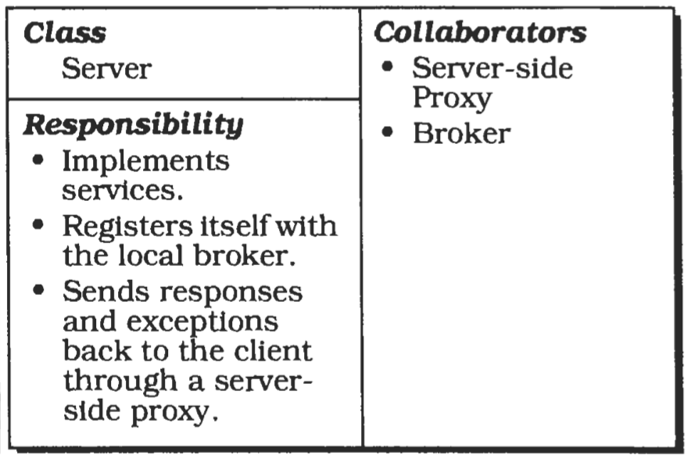
CRC diagram

Slide 85
Server: Illustration
WWW servers that provide access to HTML (Hypertext Markup Language) pages.
WWW servers are implemented as http daemon processes (hypertext transfer protocol daemon) that wait on specific ports for incoming requests.
When a request arrives at the server, the requested document and any additional data is sent to the client using data streams.
The HTML pages contain documents as well as CGI (Common Gateway interface) scripts for remotely-executed operations on the network host-the remote machine from which the client received the HTML- page.
A CGI script may be used to allow the user fill out a form and submit a query, for example a search request for vacant hotel rooms.
To display animations on the client's browser, Java 'applets' are integrated into the HTML documents.
For example, one of these Java applets animates the route between one place and another on a city map.
Java applets run on top of a virtual machine that is part of the WWW browser.
CGI scripts and Java applets differ from each other: CGI scripts are executed on the server machine, whereas Java applets are transferred to the WWW browser and then executed on the client machine.

Slide 86
Client
Clients are applications that access the services of at least one server.
To call remote services, clients forward requests to the broker.
After an operation has executed they receive responses or exceptions from the broker.
The interaction between clients and servers is based on a dynamic model, which means that servers may also act as clients.
This dynamic interaction model differs from the traditional notion of Client-Server computing in that the roles of clients and servers are not statically defined.
From the viewpoint of an implementation, you can consider clients as applications and servers as libraries-though other implementations are possible.
Note that clients do not need to know the location of the servers they access.
This is important, because it allows the addition of new services and the movement of existing services to other locations, even while the system is running.

Slide 87
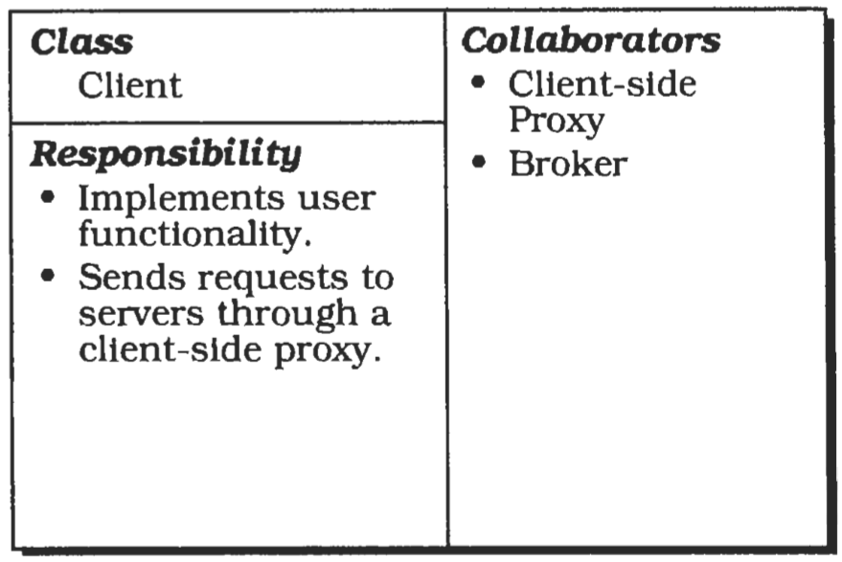
CRC Diagram

Slide 88
Client: Illustration
In the context of the Broker pattern, the clients are the available WWW browsers.
They are not directly connected to the network. Instead, they rely on Internet providers that offer gateways to the Internet, such as vsnl.
WWW browsers connect to these workstations, using either a modem or a leased line.
When connected they are able to retrieve data streams from httpd servers, interpret this data and initiate actions such as the display of documents on the screen or the execution of Java applets.

Slide 89
Broker
A broker is a messenger that is responsible for the transmission of requests from clients to servers, as well as the transmission of responses and exceptions back to the client.
A broker must have some means of locating the receiver of a request based on its unique system identifier. A broker offers APIs (Application Programming Interfaces) to clients and servers that include operations for registering servers and for invoking server methods.
When a request arrives for a server that is maintained by the local broker, the broker passes the request directly to the server.
If the server is currently inactive, the broker activates it.
All responses and exceptions from a service execution are forwarded by the broker to the client that sent the request.
If the specified server is hosted by another broker, the local broker finds a route to the remote broker and forwards the request using this route.
There is therefore a need for brokers to interoperate.
Depending on the requirements of the whole system, additional services-such as name services or marshalling services may be integrated into the broker.

Slide 90
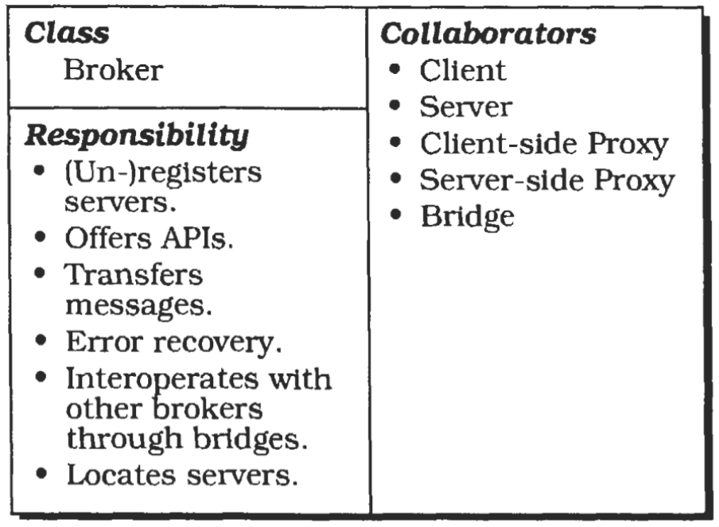
CRC Diagram

Slide 91
Some Definitions
In this pattern description we distinguish between local and remote brokers.
    A local broker is running on the machine currently under consideration.
    A remote broker is running on a remote network node.
Name services provide associations between names and objects.
    To resolve a name, a name service determines which server is associated with a given name.
    In the context of Broker systems, names are only meaningful relative to a name space.
Marshalling is the semantic-invariant conversion of data into a machine independent format such as
    ASN.1 (Abstract Syntax Notation or
    ONC XDR [external Data Representation).
Marshalling performs the reverse transformation.

Slide 92
Broker: Illustration
A broker may be a combination of an Internet gateway and the Internet infrastructure itself.
Every information exchange between a client and a server must pass through the broker.
A client specifies the information it wants using unique identifiers called URLs (Universal Resource Locators).
By using these identifiers the broker is able to locate the required services and to route the requests to the appropriate server machines.
When a new server machine is added, it must be registered with the broker.
Clients and servers use the gateway of their Internet provider as an interface to the broker.

Slide 93
Client-side proxies
Client-side proxies represent a layer between clients and the broker.
This additional layer provides transparency, in that a remote object appears to the client as a local one.
In detail, the proxies allow the hiding of implementation details from the clients such as:
    The inter-process communication mechanism used for message transfers between clients and brokers.
    The creation and deletion of memory blocks.
    The marshalling of parameters and results.
In many cases, client-side proxies translate the object model specified as part of the Broker architectural pattern to the object model of the programming language used to implement the client.

Slide 94
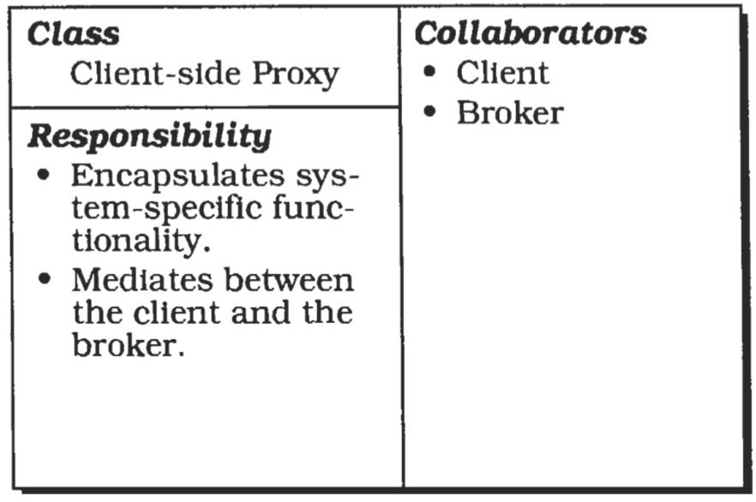
CRC Diagram

Slide 95
Server Side Proxy
Sewer-side proxies are generally analogous to Client-side proxies.
The difference is that they are responsible for receiving requests, unpacking incoming messages, marshalling the parameters, and calling the appropriate service.
They are used in addition for marshalling results and exceptions before sending them to the client.

Slide 96
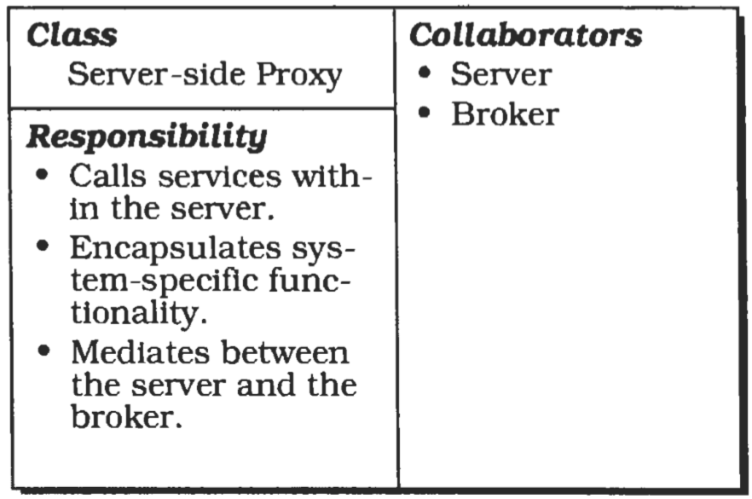
CRC Diagram

Slide 97
Bridges
Bridges are optional components used for hiding implementation details when two brokers interoperate.
Suppose a Broker system runs on a heterogeneous network.
If requests are transmitted over the network, different brokers have to communicate independently of the different network and operating systems in use.
A bridge builds a layer that encapsulates all these system-specific details.

Slide 98
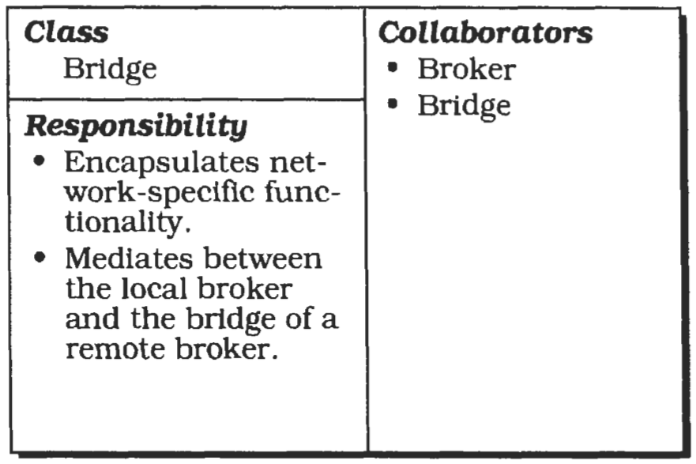
CRC Diagram

Slide 99
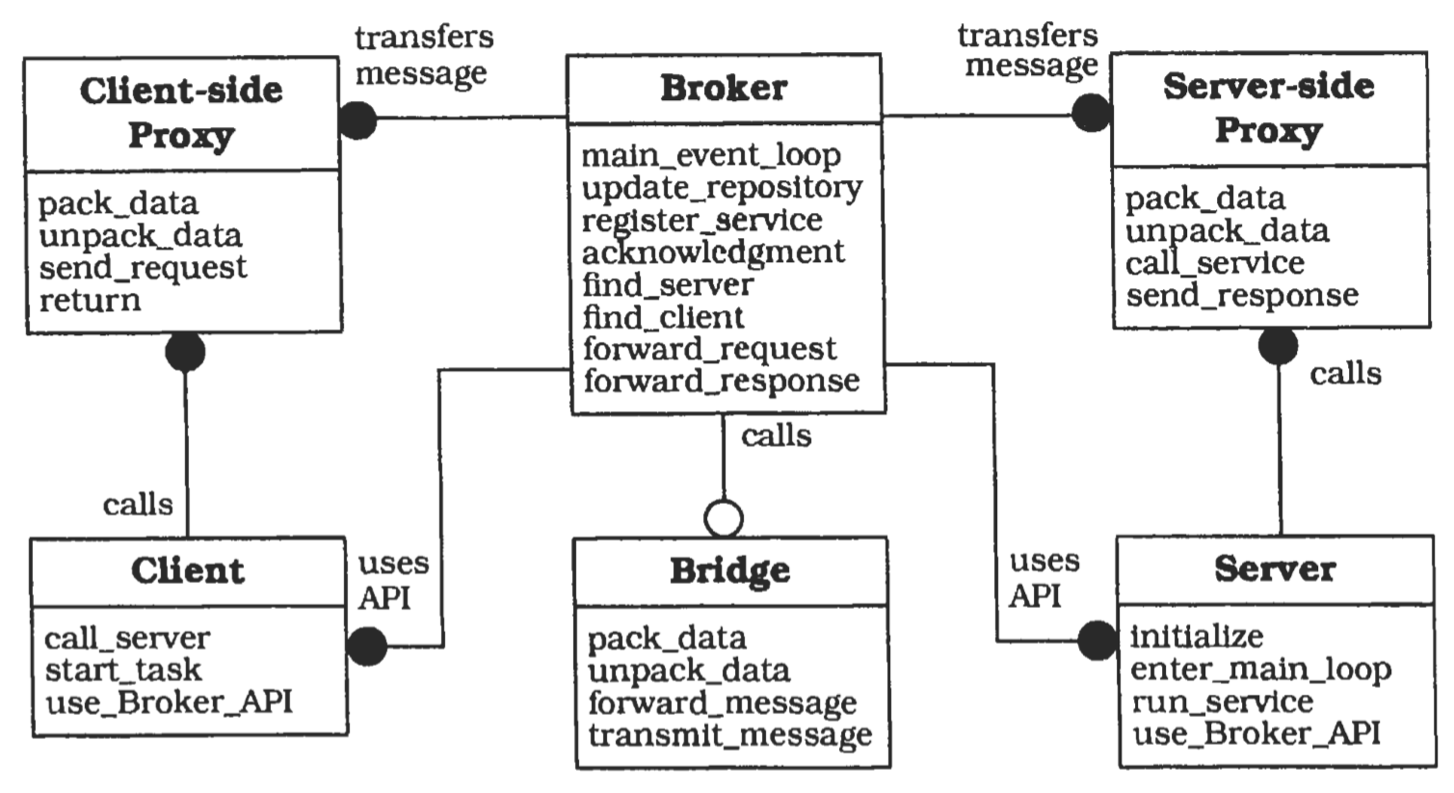
Broker System

Slide 100
Implementation
Define an object model, or use an exlsling model
Decide which kind of component-interoperability the system should offer.
Specify the APIs the broker component provides for collaborating with clients and servers.
Use proxy objects to hide implementation details from clients and servers.
Design the broker component in parallel with steps 3 and 4. (Note the steps involved)
Develop IDL compilers.

Slide 101
Variants
Direct Communication Broker System
Message Passing Broker System
Trader System
Adapter Broker System
Callback Broker System

Slide 102
Known Usages
CORBA
IBM SOM/DSOM
Microsoft's OLE 2.x
World Wide Web
ATM-P.

Slide 103
Consequences: benefits
Location Transparency
Changeability and extensibility of components
Portability of a Broker system
Interoperability between dzflerent Broker systems.
Reusability
Testing and Debugging

Slide 104
Consequences: Liabilities
Restricted efficiency
Lower fault tolerance
Testing and Debugging

Slide 105
Thank you
End of Part 3 or 4

Slide 106
Module 6 CS 09
Patterns – Part 4
Interactive Systems – MVC/PAC
Harvinder S Jabbal
SSZG653 Software Architectures

Slide 107
Categories
From Mud to Structure.
Patterns in this category help you to avoid a 'sea' of components or objects.
In particular, they support a controlled decomposition of an overall system task into cooperating subtasks.
The category includes
  the Layers pattern
  the Pipes and Filters pattern
  the Blackboard pattern
Distributed Systems.
This category includes one pattern.
  Broker
and refers to two patterns in other categories,
  Microkernel
  Pipes and Filters
The Broker pattern provides a complete infrastructure for distributed applications.
The Microkernel and Pipes and Filters patterns only consider distribution as a secondary concern and are therefore listed under their respective primary categories.
Interactive Systems.
This category comprises two patterns,
  the Model-View-Controller pattern (well-known from Smalltalk,)
  the Presentation-Abstraction-Control pattern.
Both patterns support the structuring of software systems that feature human-computer interaction.
Adaptable Systems.
This category includes
  The Reflection pattern
  the Microkernel pattern
strongly support extension of applications and their adaptation to evolving technology and changing functional requirements.

Slide 108
Interactive Systems
This category comprises two patterns,
    the Model-View-Controller pattern
    (well-known from Smalltalk,)
    the Presentation-Abstraction-Control pattern.
Both patterns support the structuring of software systems that feature human-computer interaction.

Slide 109
Interactive Systems

Slide 110
User Interaction
Today's systems allow a high degree of user interaction, mainly achieved with help of graphical user interfaces.
The objective is to enhance the usability of an application.
Usable software systems provide convenient access to their services, and therefore allow users to learn the application and produce results quickly.

Slide 111
user interface
When specifying the architecture of such systems, the challenge is to keep the functional core independent of the user interface.
The core of interactive systems is based on the functional requirements for the system, and usually remains stable.
User interfaces, however, are often subject to change and adaptation.
For example, systems may have to support different user interface standards, customer-specific 'look and feel' metaphors, or interfaces that must be adjusted to fit into a customer's business processes.
This requires architectures that support the adaptation of user interface parts without causing major effects to application-specific functionality or the data model underlying the software.

Slide 112
Model-View-Controller pattern (MVC)
MVC divides an interactive application into three components.
    The model contains the core functionality and data.
    Views display information to the user.
    Controllers handle user input.
Views and controllers together comprise the user interface.
A change-propagation mechanism ensures consistency between the user interface and the model.

Slide 113
The Presentation-Abstraction-Control pattern (PAC)
PAC defines a structure for interactive software systems in the form of a hierarchy of cooperating agents.
Every agent is responsible for a specific aspect of the application's functionality and consists of three components:
    presentation,
    abstraction, and
    control.
This subdivision separates the human-computer interaction aspects of the agent from its functional core and its communication with other agents.

Slide 114
Model-View-Controller

Slide 115
Model-View-Controller
The MVC divides an interactive application into three components.
    The model contains the core functionality and data.
    Views display information to the user.
    Controllers handle user input.
Views and controllers together comprise the user interface.
A change-propagation mechanism ensures consistency between the user interface and the model.

Slide 116
Context
Interactive applications with a flexible human-computer interface.

Slide 117
Problem
User interfaces are especially prone to change requests. When you extend the functionality of an application, you must modify menus to access these new functions.
A customer may call for a specific user interface adaptation, or a system may need to be ported to another platform with a different 'look and feel' standard.
Even upgrading to a new release of your windowing system can imply code changes.
The user interface platform of long-lived systems thus represents a moving target.

Slide 118
Problem
Different users place conflicting requirements on the user interface.
A typist enters information into forms via the keyboard.
A manager wants to use the same system mainly by clicking icons and buttons.
Consequently, support for several user interface paradigms should be easily incorporated.
Building a system with the required flexibility is expensive and error-prone if the user interface is tightly interwoven with the functional core.
This can result in the need to develop and maintain several substantially different software systems, one for each user interface implementation.
Ensuing changes spread over many modules.

Slide 119
Influences
The following forces influence the solution:
The same information is presented differently in different windows, for example, in a bar or pie chart.
The display and behaviour of the application must reflect data manipulations immediately.
Changes to the user interface should be easy, and even possible at run-time.
Supporting different 'look and feel' standards or porting the user interface should not affect code in the core of the application.

Slide 120
Solution
Model-View-Controller (MVC] was first introduced in the Smalltalk-80 programming environment.
MVC divides an interactive application into the three areas:
    processing,
    output, and
    input.

Slide 121
Model
The model component encapsulates core data and functionality.
The model is independent of specific output representations or input behaviour.

Slide 122
View
View components display information to the user. A view obtains the data from the model.
There can be multiple views of the model.

Slide 123
Controller
Each view has an associated controller component.
Controllers receive input, usually as events that encode mouse movement, activation of mouse buttons, or keyboard input.
Events are translated to service requests for the model or the view.
The user interacts with the system solely through controllers.

Slide 124
MVC
The separation of the model from view and controller components allows multiple views of the same model.
If the user changes the model via the controller of one view, all other views dependent on this data should reflect the changes.
The model therefore notifies all views whenever its data changes.
The views in turn retrieve new data from the model and update the displayed information.
This change- propagation mechanism is described in the Publisher-Subscriber pattern

Slide 125
Structure: Model
The model component contains the functional core of the application.
It encapsulates the appropriate data, and exports procedures that perform application-specific processing.
Controllers call these procedures on behalf of the user.
The model also provides functions to access its data that are used by view components to acquire the data to be displayed.
The change-propagation mechanism maintains a registry of the dependent components within the model.
All views and also selected controllers register their need to be informed about changes.
Changes to the state of the model trigger the change-propagation mechanism.
The change-propagation mechanism is the only link between the model and the views and controllers.

Slide 126
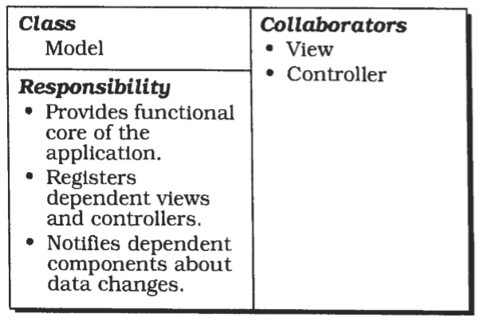
CRC Diagram

Slide 127
Structure: View
View components present information to the user.
Different views present the information of the model in different ways.
Each view defines an update procedure that is activated by the change- propagation mechanism.
When the update procedure is called, a view retrieves the current data values to be displayed from the model, and puts them on the screen.
During initialization all views are associated with the model, and register with the change-propagation mechanism.
Each view creates a suitable controller.
There is a one-to-one relationship between views and controllers.
Views often offer functionality that allows controllers to manipulate the display.
This is useful for user-triggered operations that do not affect the model, such as scrolling.

Slide 128
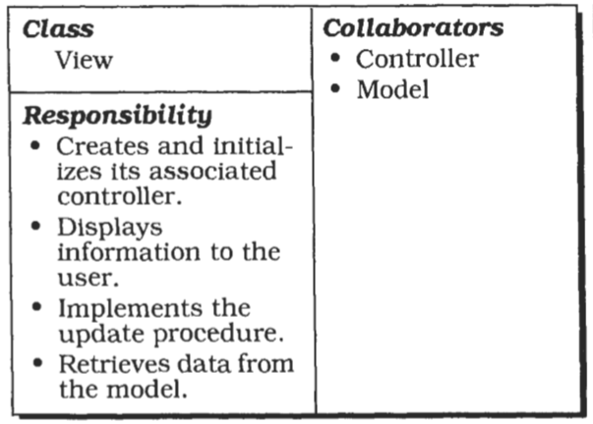
CRC Diagram

Slide 129
Structure: Controller
The controller components accept user input as events.
How these events are delivered to a controller depends on the user interface platform.
For simplicity, let us assume that each controller implements an event-handling procedure that is called for each relevant event.
Events are translated into requests for the model or the associated view.
If the behaviour of a controller depends on the state of the model, the controller registers itself with the change-propagation mechanism and implements an update procedure.
For example, this is necessary when a change to the model enables or disables a menu entry.

Slide 130
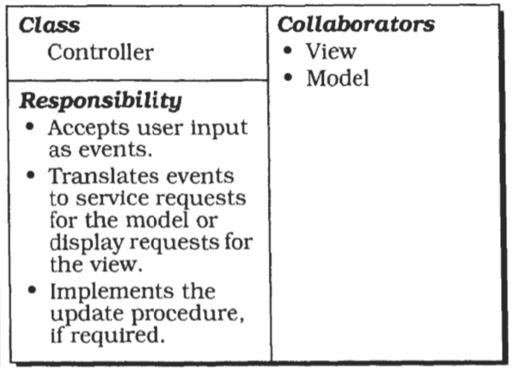
CRC Diagram

Slide 131
Popular Structural Variations
Object Oriented
    implementation of MVC would define a separate class for each component
C++
    view and controller classes share a common parent that defines the update interface.
Smalltalk.
    the class Object dehes methods for both sides of the change- propagation mechanism.
    A separate class Observer is not needed.

Slide 132
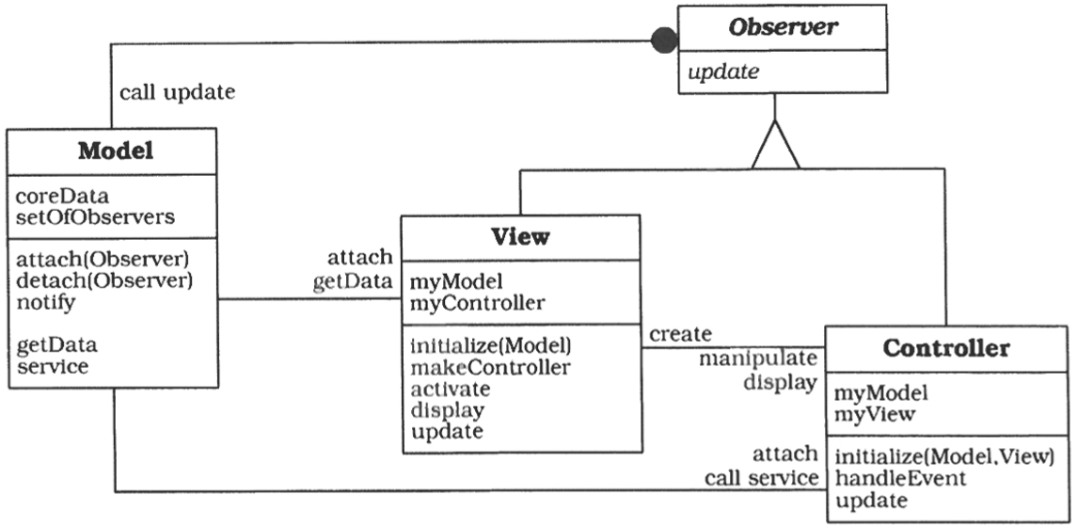
Structure: C++

Slide 133
Implementation
Separate human-computer interactionfrom corefunctionality
Implement the change-propagationm echanism
Design and implement the views
Design and implement the controllers
Design and implement the view-controller relationship
Implement the set-up of MVC
Dynamic view creation
'Pluggable controllers
Infrastructure for hierarchical views and controllers
Further decoupling from system dependencies

Slide 134
Variants
Document-View
    This variant relaxes the separation of view and controller.
    In several GUI platforms, window display and event handling are closely interwoven.
    For example, the X Window System reports events relative to a window.
    You can combine the responsibilities of the view and the controller from MVC in a single component by sacrificing exchangeability of controllers.

Slide 135
Known Usages
Smalltalk
    The VisualWorks Smalltalk environment supports different 'look and feel' standards by decoupling view and controllers via display and sensor classes
MFC (Microsoft Foundation Class Library)
    The Document-View variant of the Model-View- Controller pattern is integrated in the Visual C++ environment
ET++
    Establishes 'look and feel' independence by defining a class Window port that encapsulates the user interface platform dependencies, in the same way as do our display and sensor classes. Uses document-view variant.

Slide 136
Consequences: Benefits
Multiple views of the same model
Synchronized views.
'Pluggable' views and controllers.
Exchangeability of 'look and feel’.
Framework Potential.

Slide 137
Consequences: Liabilities
Increased complexity.
Potential for excessive number of updates.
Intimate connection between view and controller.
Close coupling of views and controllers to a model.
Inefficiency of data access in view.
Inevitability of change to view and controller when porting.
Difficulty of using MVC with modern user-interface took.

Slide 138
PAC: Presentation-Abstraction-Control

Slide 139
Presentation-Abstraction-Control
The Presentation-Abstraction-Control architectural pattern (PAC) defines a structure for interactive software systems in the form of a hierarchy of cooperating agents.
Every agent is responsible for a specific aspect of the application's functionality and consists of three components: presentation, abstraction, and control.
This subdivision separates the human-computer interaction aspects of the agent from its functional core and its communication with other agents

Slide 140
Context
Development of an interactive application with the help of agents.
In the context of this pattern an agent denotes an information-processing component that includes event receivers and transmitters, data structures to maintain stale, and a processor that handles incoming events, updates its own state, and that may produce new events.
Agents can be as small as a single object, but also as complex as a complete software system.
We use the terms agent and PAC agent as synonyms in this pattern description

Slide 141
Problem
Interactive systems can often be viewed as a set of cooperating agents.
Agents specialized in human-computer interaction accept user input and display data.
Other agents maintain the data model of the system and offer functionality that operates on this data.
Additional agents are responsible for diverse tasks such as error handling or communication with other software systems.
Besides this horizontal decomposition of system functionality, we often encounter a vertical decomposition.

Slide 142
Example
Production planning systems (PPS) , for example, distinguish between production planning and the execution of a previously specified production plan.
For each of these tasks separate agents can be defined.
In such an architecture of cooperating agents, each agent is specialized for a specific task, and all agents together provide the system functionality.
This architecture also captures both a horizontal and vertical decomposition.

Slide 143
Forces
Agents often maintain their own state and data.
  For example, in a PPS system, the production planning and the actual production control may work on different data models, one tuned for planning and simulation and one performance-optimized for efficient production.
  However, individual agents must effectively cooperate to provide the overall task of the application.
  To achieve this, they need a mechanism for exchanging, data, messages, and events.
Interactive agents provide their own user interface, since their respective human-computer interactions often differ widely.
  For example, entering data into spreadsheets is done using keyboard input, while the manipulation of graphical objects uses a pointing device.
Systems evolve over time.
  Their presentation aspect is particularly prone to change.
  The use of graphics, and more recently, multi-media features, are examples of pervasive changes to user interfaces.
  Changes to individual agents, or the extension of the system with new agents, should not affect the whole system.

Slide 144
Solution
Structure the interactive application as a tree-like hierarchy of PAC agents.
There should be one top-level agent, several intermediate-level agents, and even more bottom-level agents.
Every agent is responsible for a specific aspect of the application's functionality, and consists of three components: presentation, abstraction, and control.
The whole hierarchy reflects transitive dependencies between agents.
Each agent depends on all higher-level agents up the hierarchy to the top-level agent.

Slide 145
Agents
The agent's presentation component provides the visible behaviour of the PAC agent.
Its abstraction component maintains the data model that underlies the agent, and provides functionality that operates on this data.
Its control component connects the presentation and abstraction components, and provides functionality that allows the agent to communicate with other PAC agents.

Slide 146
The top-level PAC agent
The top-level PAC agent provides the functional core of the system.
Most other PAC agents depend or operate on this core. Furthermore, the top-level PAC agent includes those parts of the user interface that cannot be assigned to particular subtasks, such as menu bars or a dialog box displaying information about the application.

Slide 147
Bottom-level PAC agents
Bottom-level PAC agents represent self-contained semantic concepts on which users of the system can act, such as spreadsheets and charts.
The bottom-level agents present these concepts to the user and support all operations that users can perform on these agents, such as zooming or moving a chart.

Slide 148
Intermediate-level PAC agents
Intermediate-level PAC agents represent either combinations of, or relationships between, lower-level agents.
    For example, an intermediate-level agent may maintain several views of the same data, such as a floor plan and an external view of a house in a CAD system for architecture.

Slide 149
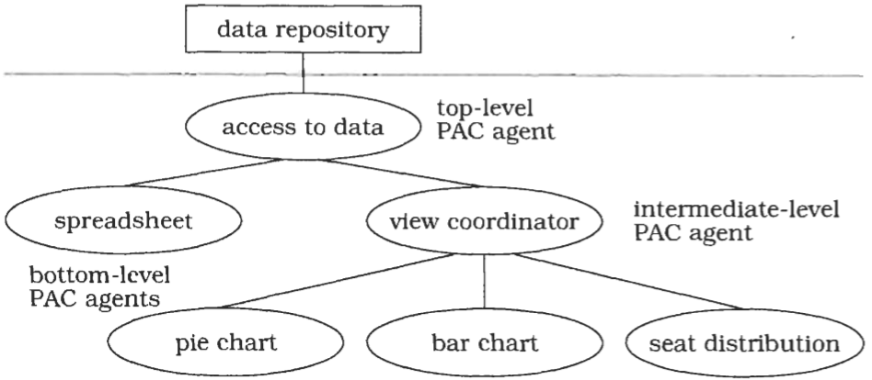
Typical Hierarchy of Agents

Slide 150
Structure: Top Level Agent
(component)
The main responsibility of the top-level PAC agent is to provide the global data model of the software.
This is maintained in the abstraction component of the top-level agent.
The interface of the abstraction component offers functions to manipulate the data model and to retrieve information about it.
The representation of data within the abstraction component is media-independent.
For example, in a CAD system for architecture, walls, doors, and windows are represented in centimetres or inches that reflect their real size, not in pixels for display purposes.
This media-independency supports adaptation of the PAC agent to different environments without major changes in its abstraction component.

Slide 151
Structure: Top Level Agent
(presentation)
The presentation component of the top-level agent often has few responsibilities.
It may include user-interface elements common to the whole application.
In some systems, such as the network traffic manager, there is no top-level presentation component at all.

Slide 152
Structure: Top Level Agent
(control)
The control component of the top-level PAC agent has three responsibilities:
1
    It allows lower-level agents to make use of the services of the top-level agents, mostly to access and manipulate the global data model.
    Incoming service requests from lower-level agents are forwarded either to the abstraction component or the presentation component.
2
    It coordinates the hierarchy of PAC agents.
    It maintains information about connections between the top-level agent and lower-level agents.
    The control component uses this information to ensure correct collaboration and data exchange between the top-level agent and lower-level agents.
3
    It maintains information about the interaction of the user with the system.
    For example, it may check whether a particular operation can be performed on the data model when triggered by the user.
    It may also keep track of the functions called to provide history or undo/redo services for operations on the functional core.

Slide 153
Bottom Level Agent
Bottom-level PAC agents represent a specific semantic concept of the application domain, such as a mailbox in a network traffic management system or a wall in a mobile robot system.
This semantic concept may be as low-level as a simple graphical object such as a circle, or as complex as a bar chart that summarizes all the data in the system.

Slide 154
Bottom Level Agent
(presentation)
The presentation component of a bottom-level PAC agent presents a specific view of the corresponding semantic concept, and provides access to all the functions users can apply to it.
Internally, the presentation component also maintains information about the view, such as its position on the screen.

Slide 155
Bottom Level Agent
(abstraction)
The abstraction component of a bottom-level PAC agent has a similar responsibility as the abstraction component of the top-level PAC agent, maintaining agent-specific data.
In contrast to the abstraction component of the top-level agent, however, no other PAC agents depend on this data.

Slide 156
Bottom Level Agent
(control)
The control component of a bottom-level PAC agent maintains consistency between the abstraction and presentation components, thereby avoiding direct dependencies between them.
It serves as an adapter and performs both interface and data adaptation.
The control component of bottom-level PAC agents communicates with higher-level agents to exchange events and data.
Incoming events-such as a 'close window' request-are forwarded to the presentation component of the bottom-level agent, while incoming data is forwarded to its abstraction component.
Outgoing events and data, for example error messages, are sent to the associated higher-level agent.

Slide 157
Bottom Level Agent
Concepts represented by bottom-level PAC agents, such as the bar and pie charts in the example, are atomic in the sense that they are the smallest units a user can manipulate. The users can only operate on the bar chart as a whole, for instance by changing the scaling factor of the y-axis. They cannot, for example, resize an individual bar of a bar chart.
Bottom-level PAC agents are not restricted to providing semantic concepts of the application domain. You can also specify bottom-level agents that implement system services.
For example, there may be a communication agent that allows the system to cooperate with other applications and to monitor this cooperation

Slide 158
Intermediate-Level PAC agents
(composition)
Intermediate-Level PAC agents can fulfil two different roles:
composition and coordination
When, for example, each object in a complex graphic is represented by a separate PAC agent, an intermediate-level agent groups these objects to form a composite graphical object.
The intermediate-level agent defines a new abstraction, whose behaviour encompasses both the behaviour of its components and the new characteristics that are added to the composite object.

Slide 159
Intermediate-Level PAC agents
(coordination)
The second role of an intermediate-level agent is to maintain consistency between lower- level agents, for example when coordinating multiple views of the same data.
The abstraction component maintains the specific data of the intermediate-level PAC agent. The presentation component implements its user interface. The control component has the same responsibilities of the control components of bottom-level PAC agents and of the top- level PAC agent.

Slide 160
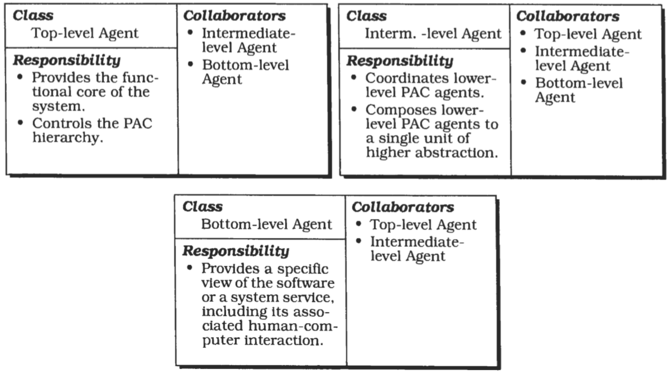
CRC Diagrams

Slide 161
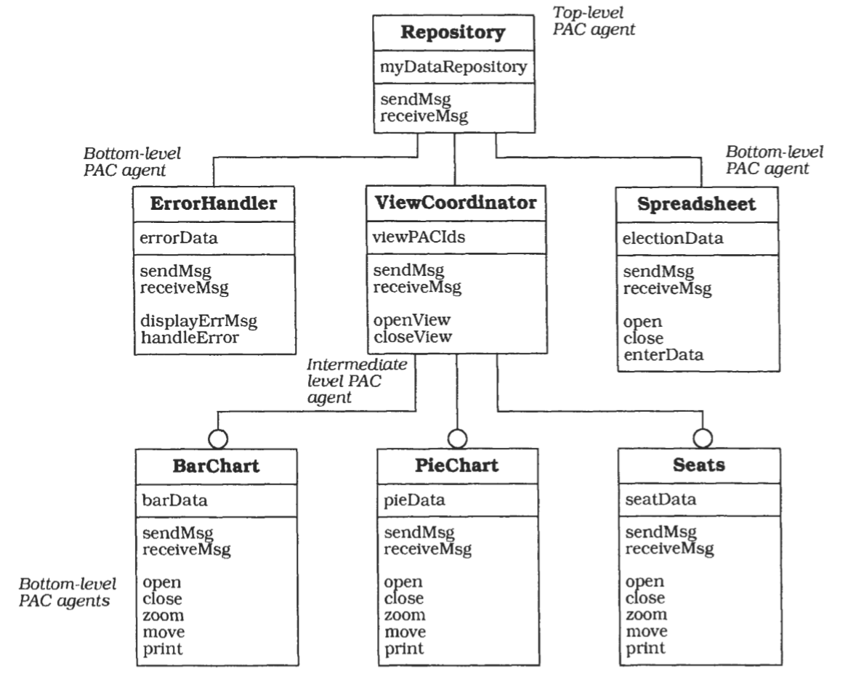
Typical PAC Object Model

Slide 162
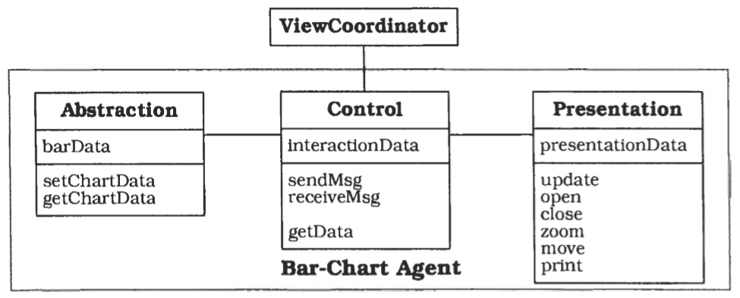
Internal Structure of a PAC Agent

Slide 163
Implementation
Define a model of the application.
Define a general strategy for organizing the PAC hierarchy
Specify the top-level PAC agent.
Specify the bottom-level PAC agents
Specih bottom-level PAC agents for system services.
Specify intermediate-level PAC agents to compose lower-level PAC agents
Specify intermediate-level PAC agents to coordinate lower-level PAC agents.
Separate core functionality from human-computer interaction
Provide the external interface.

Slide 164
Variants
Many large applications-especially interactive ones-are multi-user systems. Multi-tasking is thus a major concern when designing such software systems.
Variants
PAC agents as active objects
PAC agents as processes.

Slide 165
Known Usages
Network Traffic Management.
Mobile Robot.

Slide 166
Consequences: benefits
Separation of concerns
Support for change and extension
Support for multi-tasking

Slide 167
Consequences: Liabilities
Increased system complexity.
Complex control component
Applicability.

Slide 168
Thank you
The END

